Slide 1

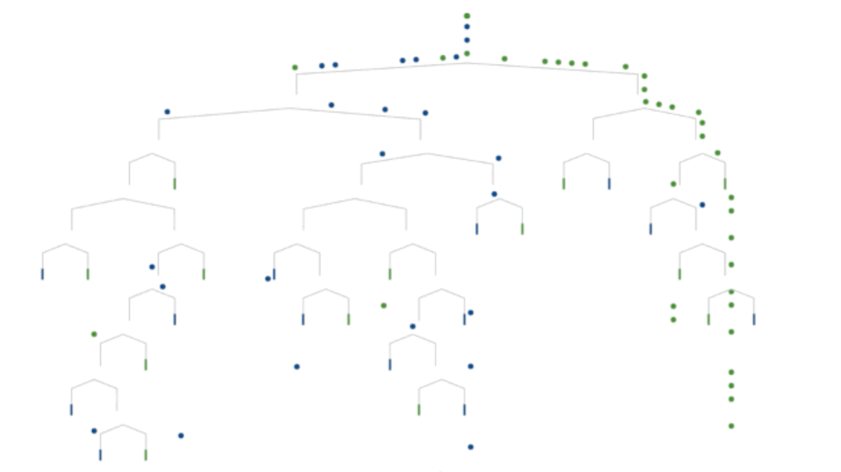
CSCI 6364/4364: Machine Learning
Lecture 1
Overview and Instanced-Based Learning
Notes:
Introduce myself

Slide 2
Logistics
Instructor: Dr. David Trott
E-mail: trottdw@gwu.edu

Slide 3
Syllabus
Course schedule and organization:
50% Homework (10% each)
20% Midterm
30% Final Project
Final grade criteria will not be harsher than:
90% --> A- or better
80% --> B- or better
70% --> C- or better

Slide 4
Syllabus
Course schedule and organization:
50% Homework (10% each)
20% Midterm
30% Final Project
Final grade criteria will not be harsher than:
90% --> A- or better
80% --> B- or better
70% --> C- or better

Slide 5

What is Machine Learning?

Slide 6
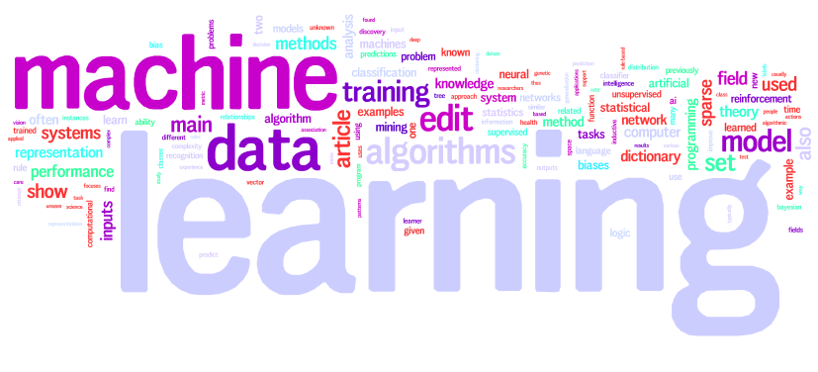
Notes:
Let the students introduce themselves, year, major, why machine learning
What are you hoping to learn at the end of this class?
What is machine learning?

Slide 7
What is machine learning?
“Learning is any process by which a system improves performance from experience.”
“Machine learning is concerned with computer programs which improve performance through experience.”
Herbert Simon

Slide 8
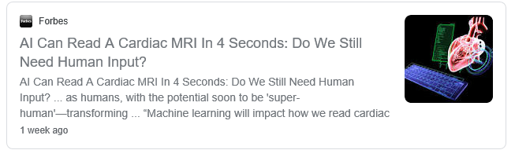
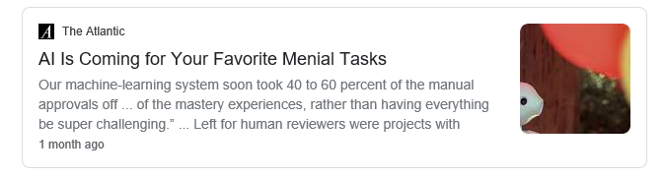
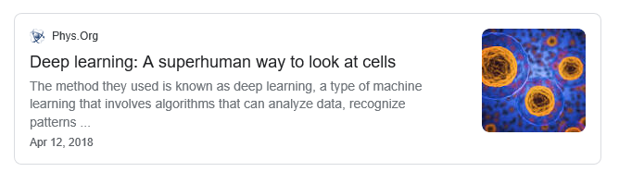
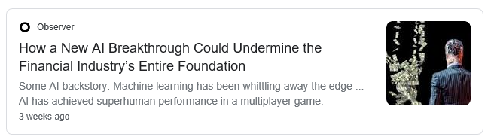
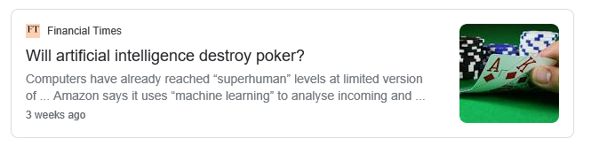
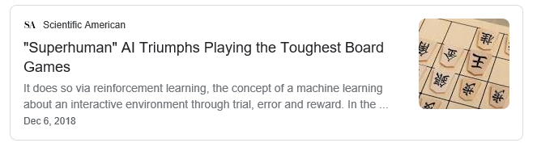
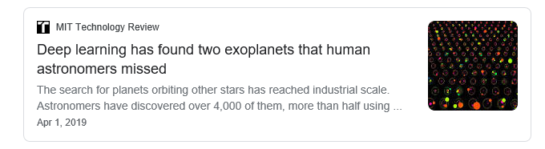
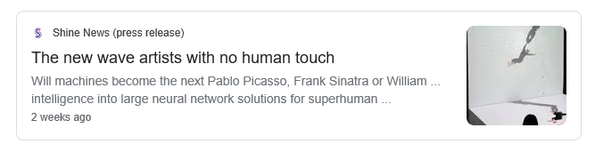
Machine Learning: The Promise
Notes:
Good Afternoon, I will be discussing Machine Learning Security and Exploitation. This is very broad field; so my goal here is to give a general overview of the topic without getting too focused on a specific area.
If you have followed the news over the past few years, you probably have noticed an explosion in the number of sensational stories talking about the super human like capabilities of machine learning. This includes applications in areas from scientific fields like astronomy and medicine, to more creative and artistic endeavors like music generation and painting. It is very clear that machine learning has the potential to profoundly impact how society performs various tasks in future.

Slide 9
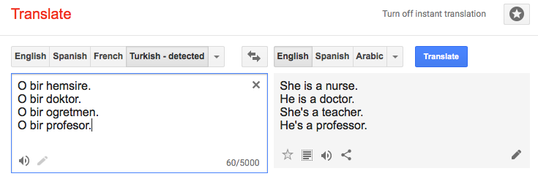
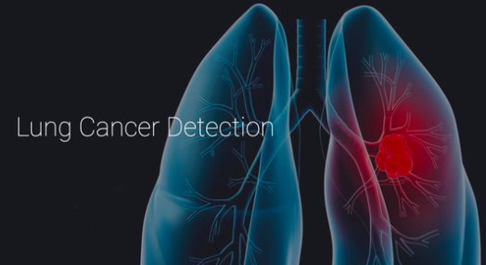
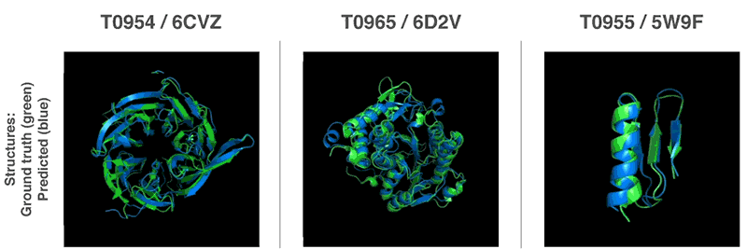
Machine learning applications - examples
Alphafold

Slide 10
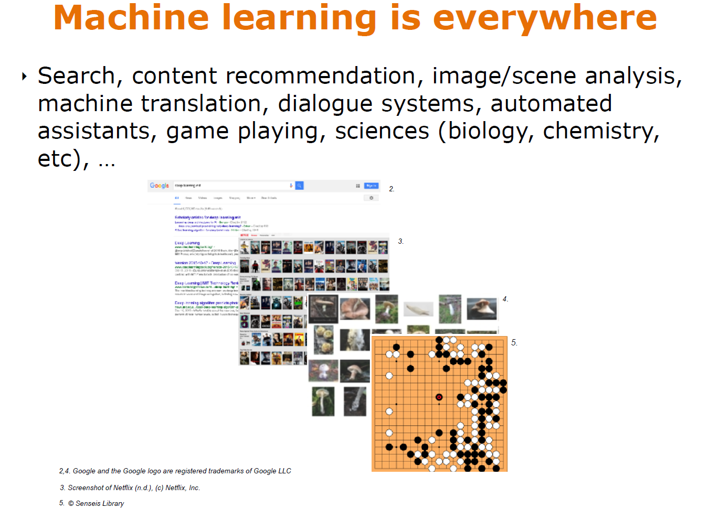

Slide 11
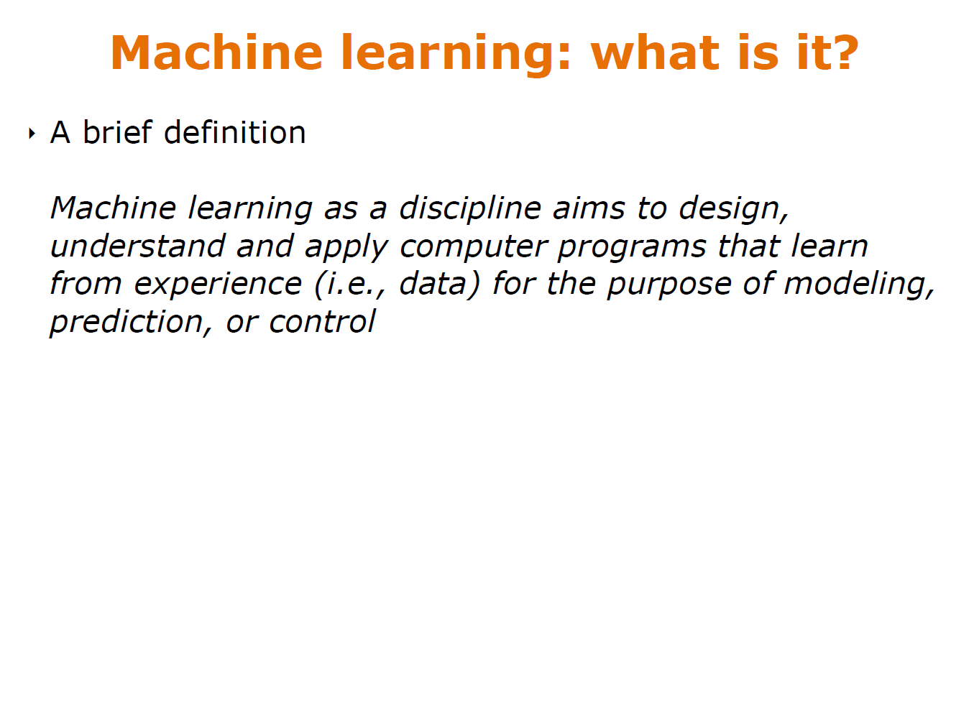

Slide 12
What is machine learning?
Machine learning is a large topic
Computational biology
Computer vision
Natural language processing
Robotics
In this course we will study:
Data preprocessing and feature selection
Model selection
Supervised and unsupervised learning algorithms
Deep learning and much more

Slide 13
Why is machine learning so popular?
Flood of available data
Computational power
Advances in algorithms and theory
Support from industry and research foundations

Slide 14
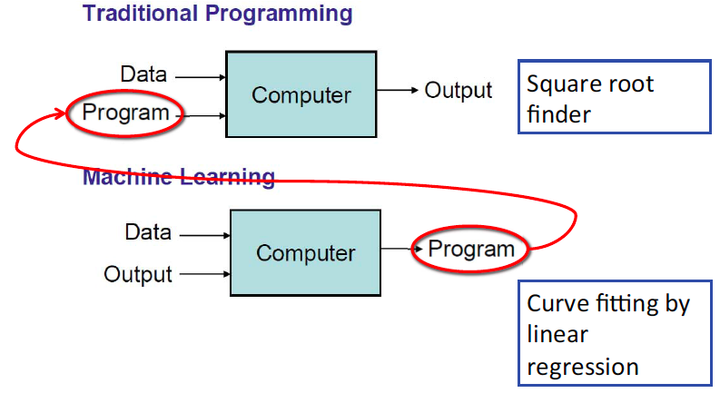
What is machine learning?

Slide 15
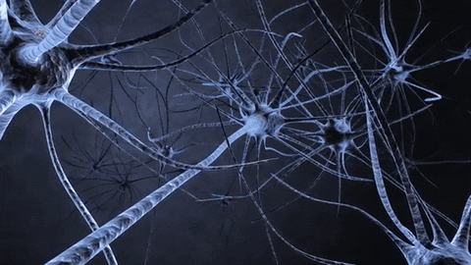
How are things learned?
Memorization
Declarative knowledge
Accumulation of individual facts
Limitation: time to observe facts and memory for fact storage
Generalization
Imperative knowledge
Deduce new facts from old facts
Assumption: past predicts the future
Limitation: accuracy of deduction process
Goal
Extend to programs that can infer useful information from implicit patterns in data

Slide 16
Deep Learning vs. Machine Learning vs. Artificial Intelligence
Deep Learning
Machine learning is a family of algorithms that improve by learning from data
A neural network is one of those algorithms
Neural networks are made up of successive layers. Deep learning models have many layers
Artificial Intelligence
Machine Learning
Deep Learning
Notes:
Artificial Intelligence as a field has been around the longest. Refers to anything that allows a compute to mimic a human. This can be machine learning or logic, association rules, decision trees, etc.
Machine Learning using statistical techniques where computers can improve with experience / more data
Deep Learning allows for hierarchical representations of data where the algorithm learns both the output and the features themselves

Slide 17
Machine learning setup
Let us formalize the supervised machine learning setup. Our training data comes in pairs of inputs (x, y), where x ∈ R^{d} is the input instance and y its label. The entire training data is denoted as:
D={(x₁,y₁), …, (x_{n},y_{n})} ⊆ R^{d} × C
where:
R^{d}: d-dimensional feature space
x_{i}: input vector of the i^{th} sample
y_{i}: label of the i^{th} sample
C: label space

Slide 18
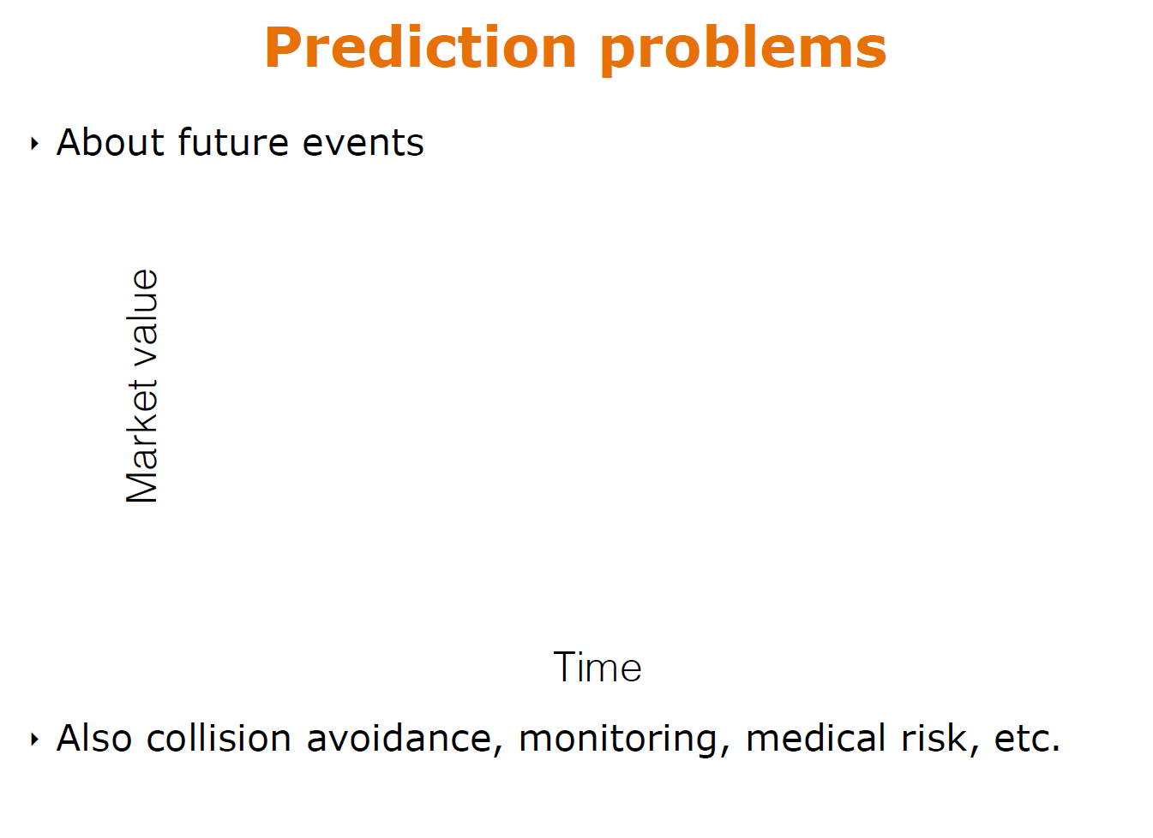

Slide 19
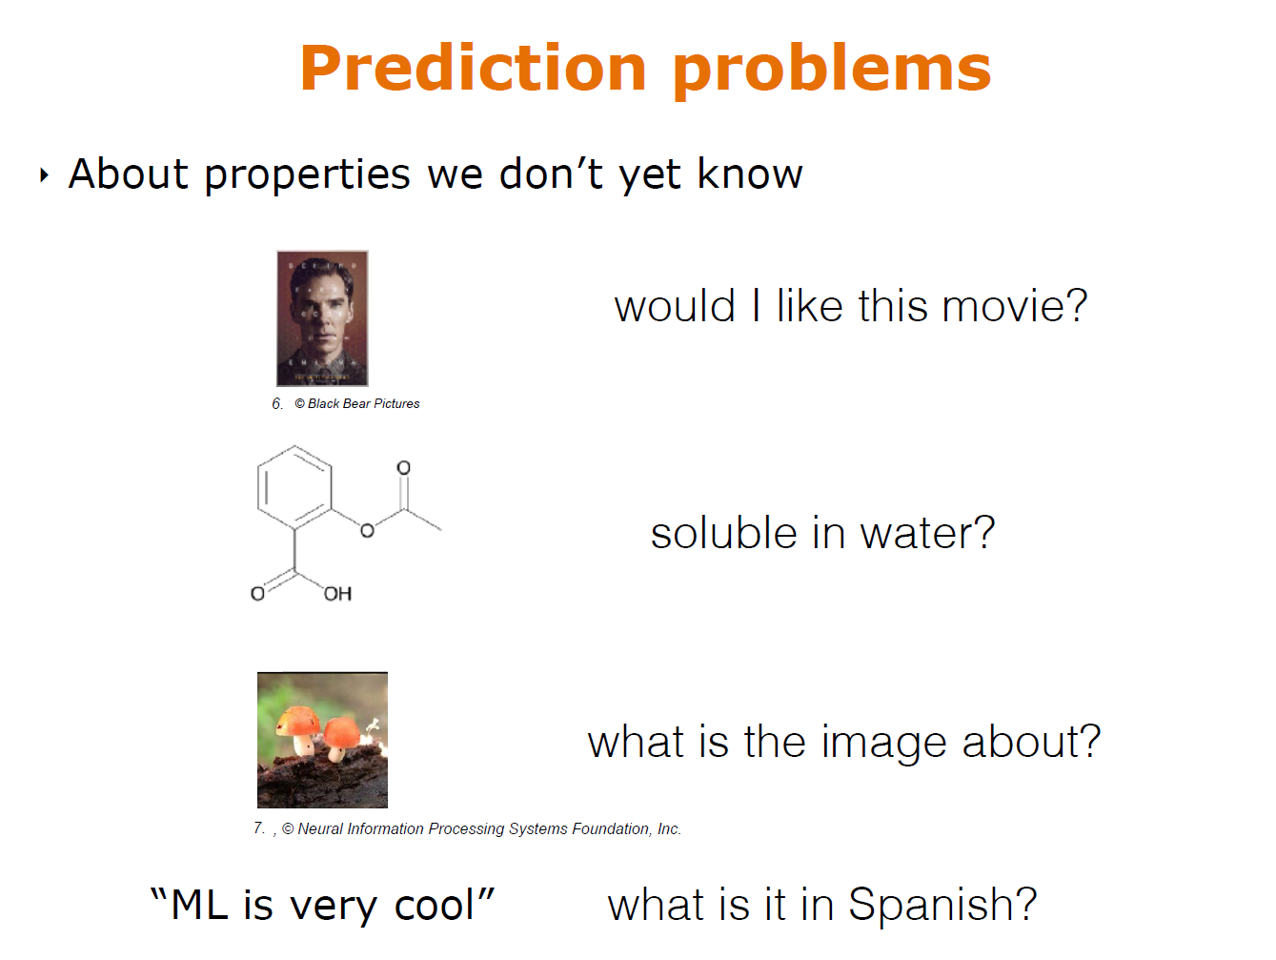

Slide 20
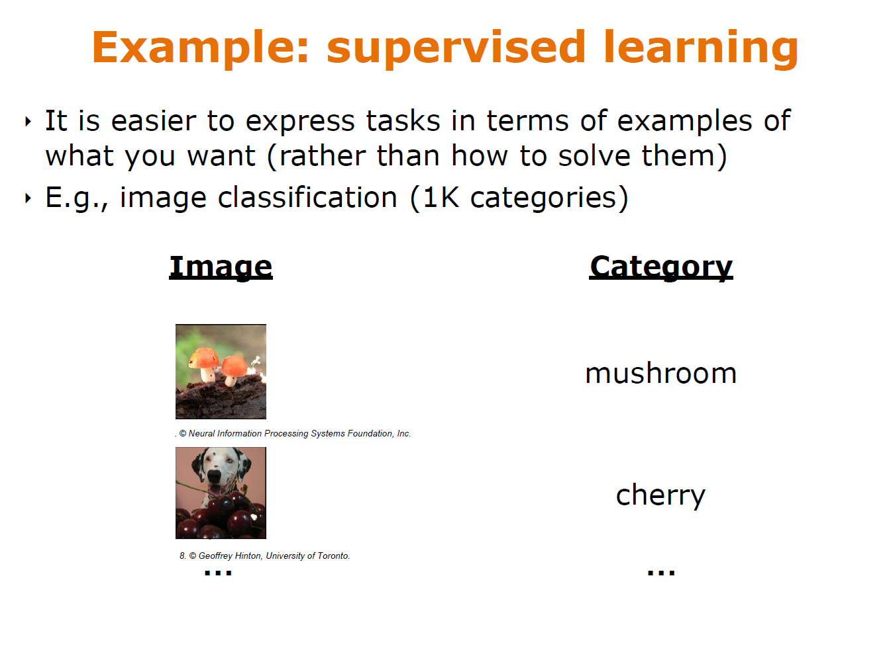

Slide 21
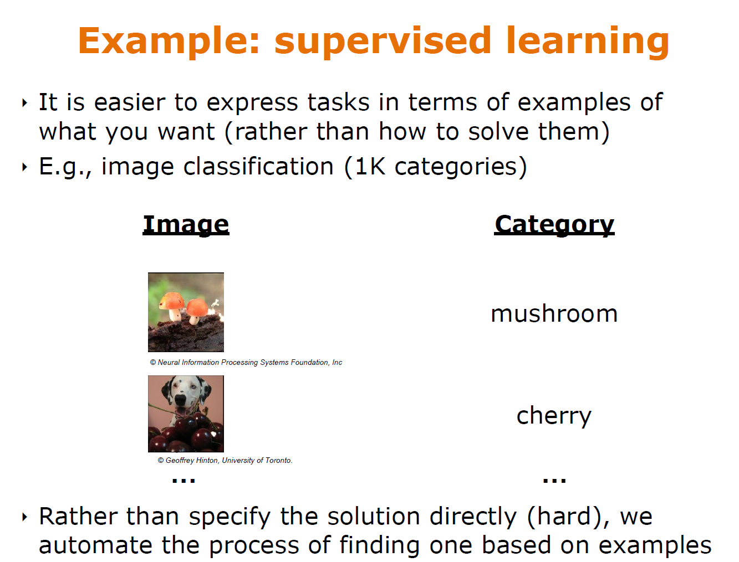

Slide 22
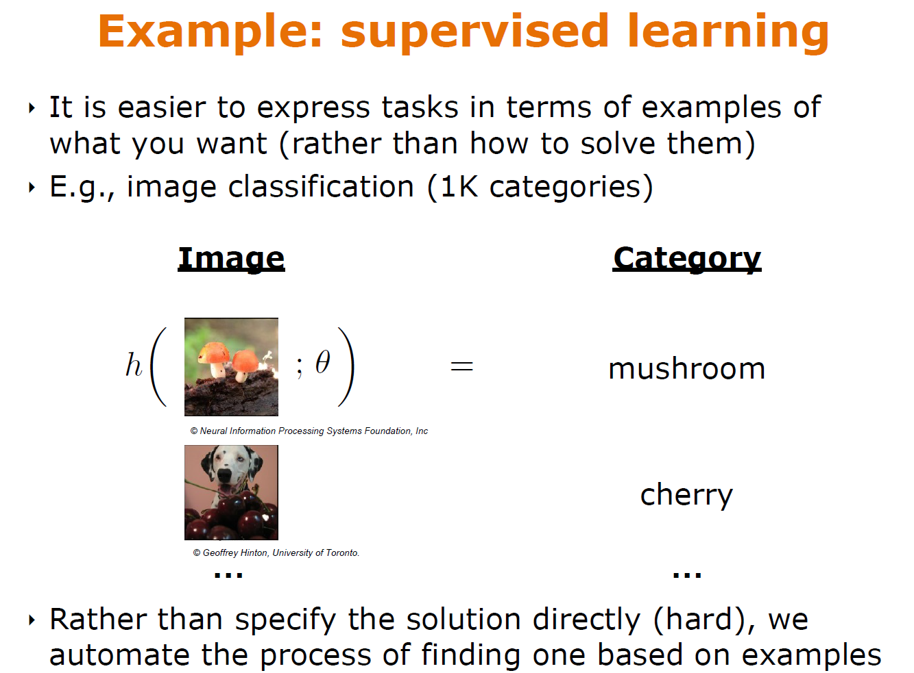

Slide 23
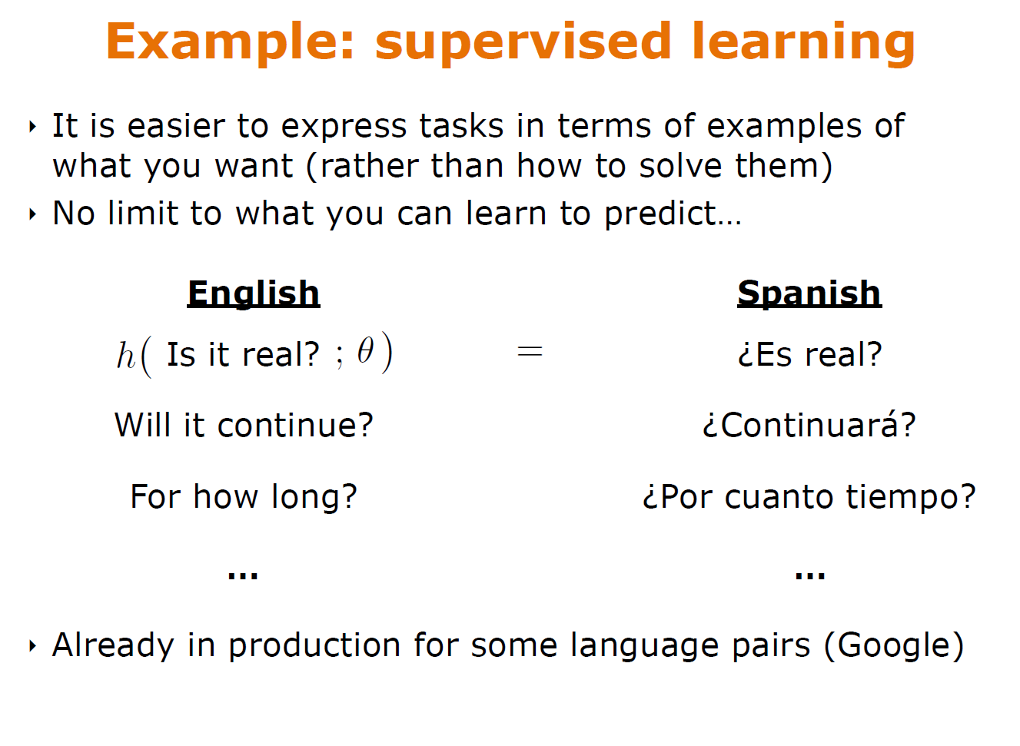

Slide 24
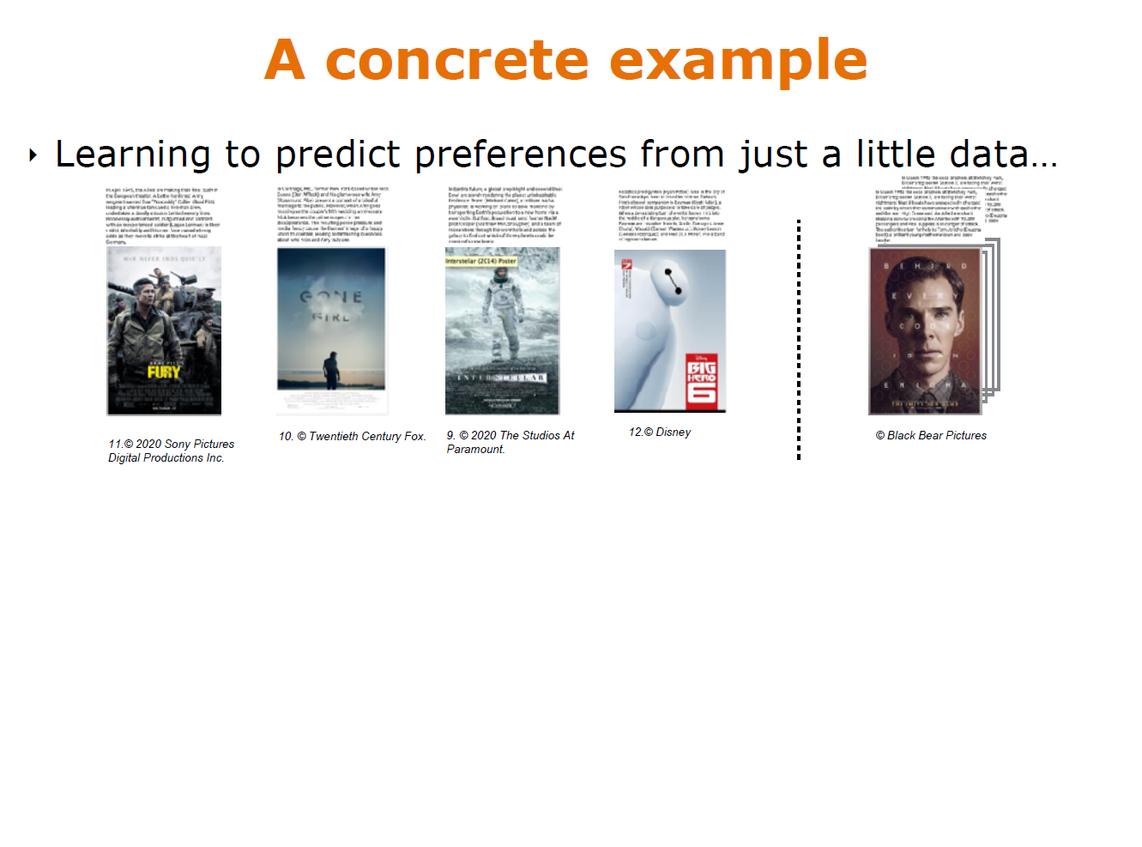

Slide 25
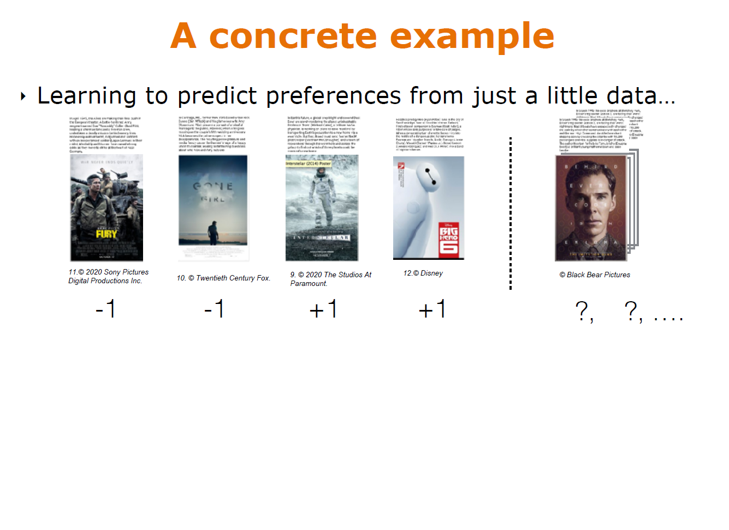

Slide 26
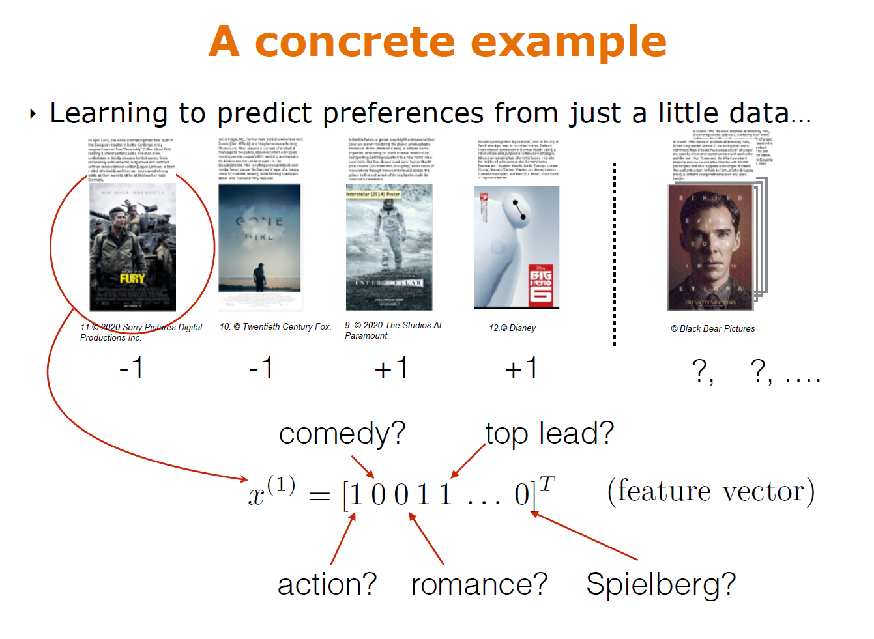

Slide 27
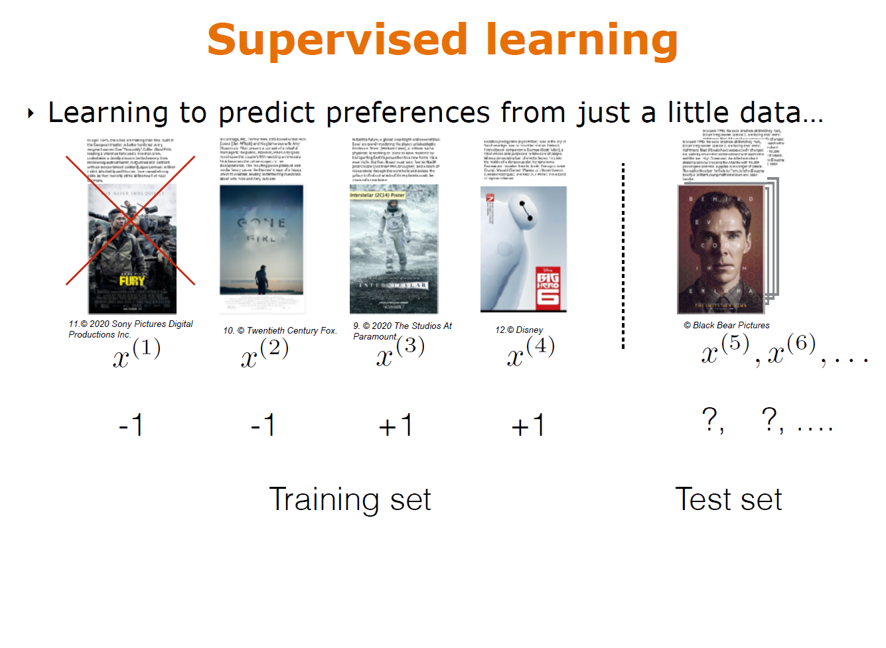

Slide 28
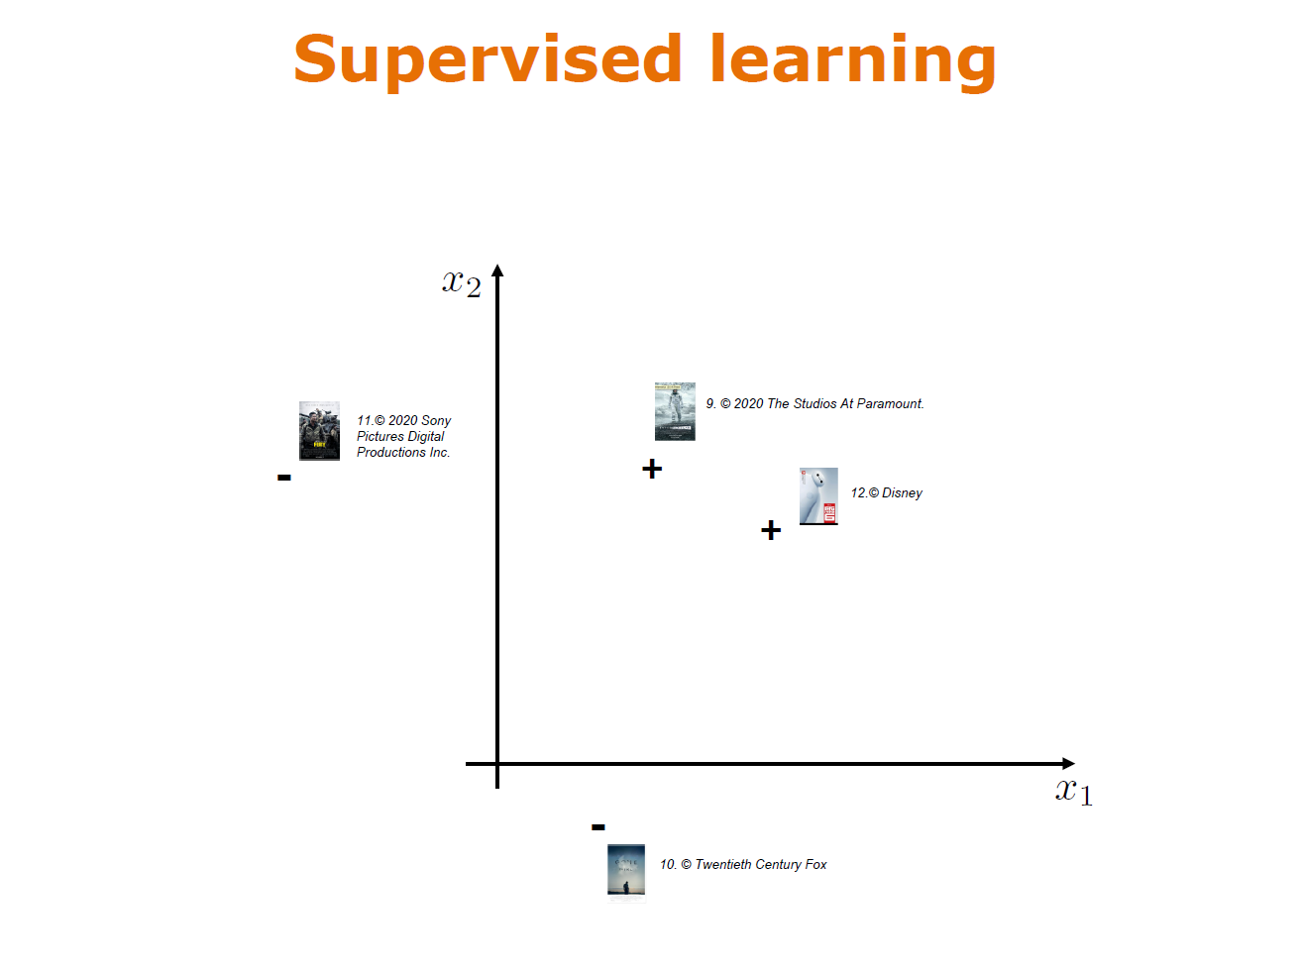

Slide 29
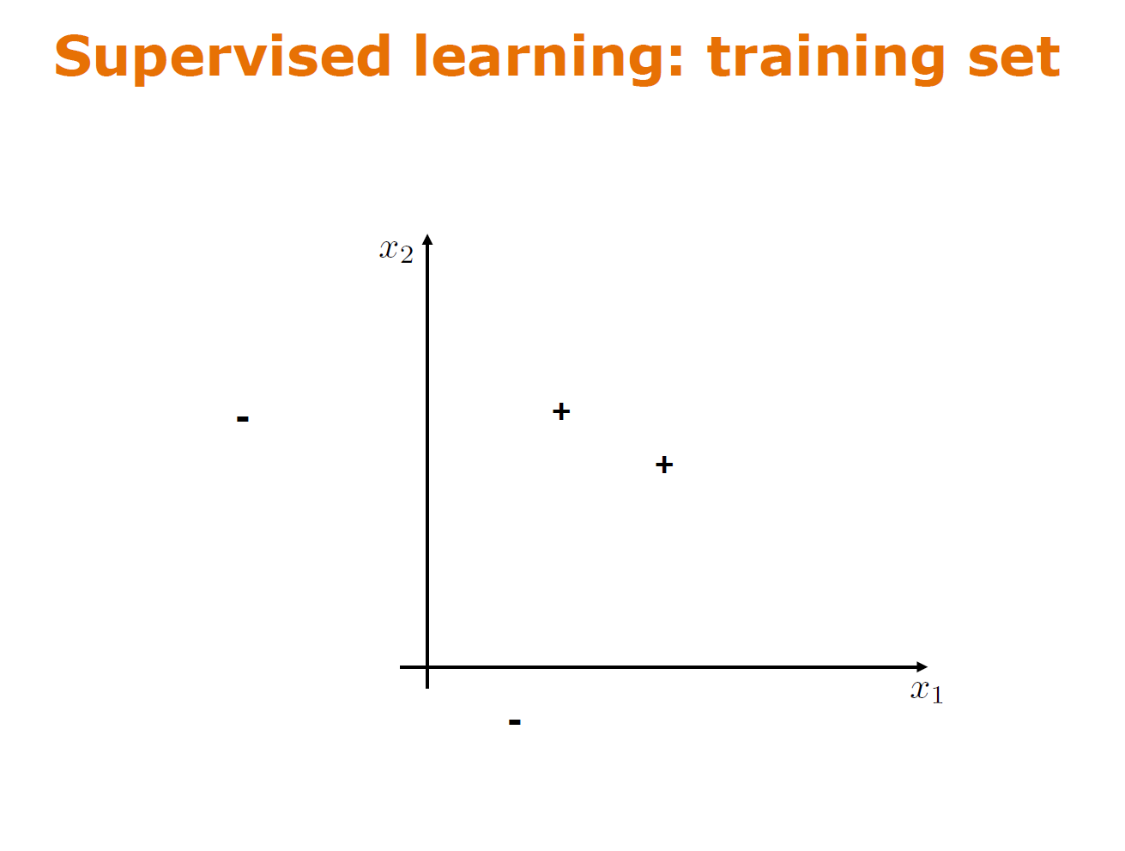

Slide 30
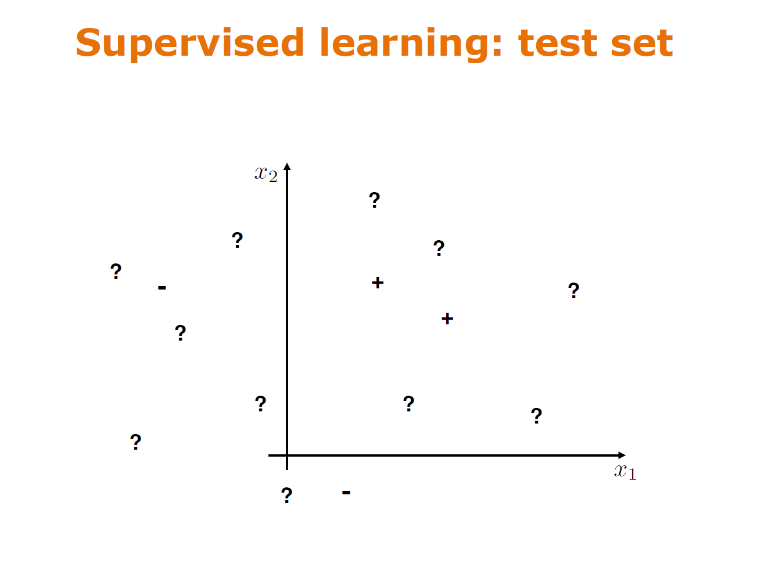

Slide 31
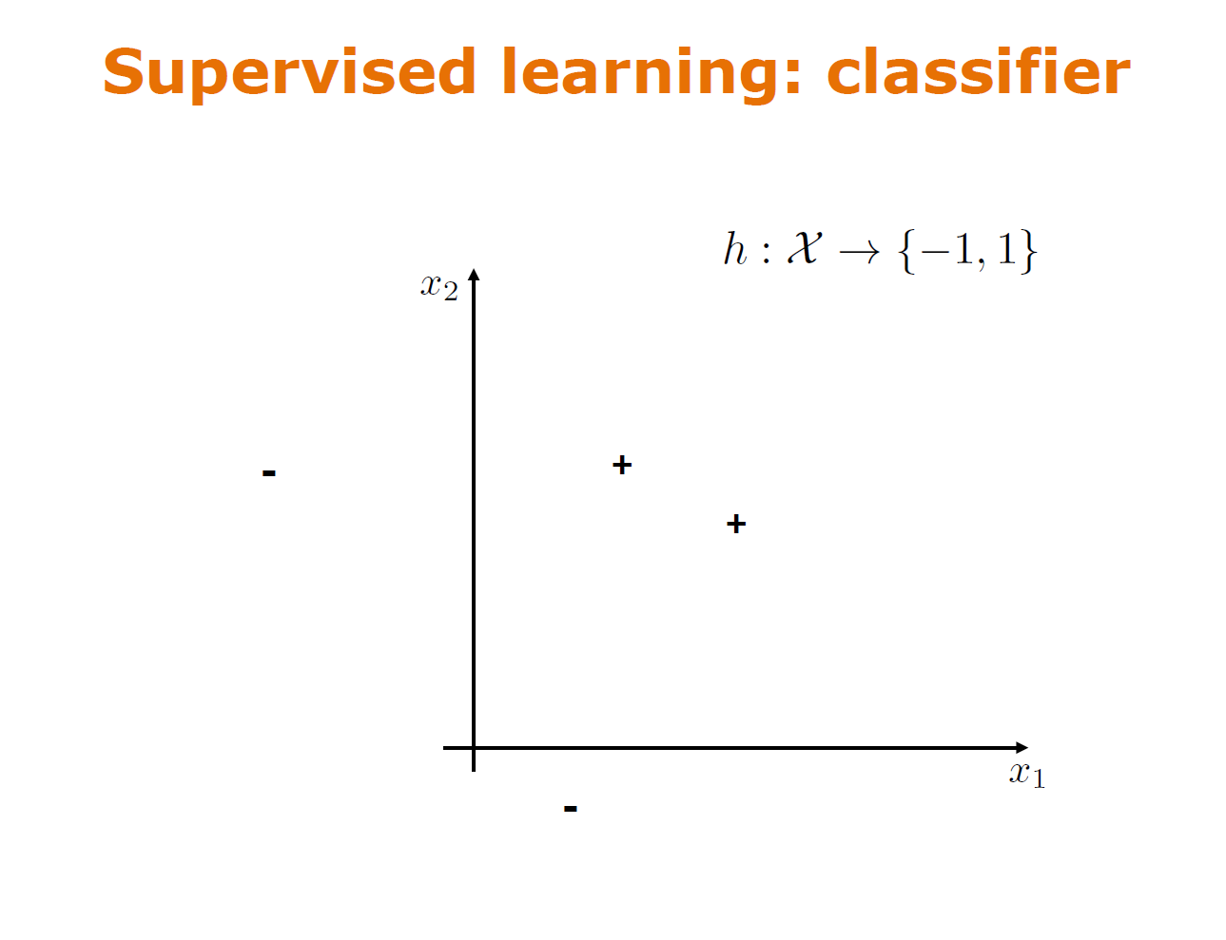

Slide 32
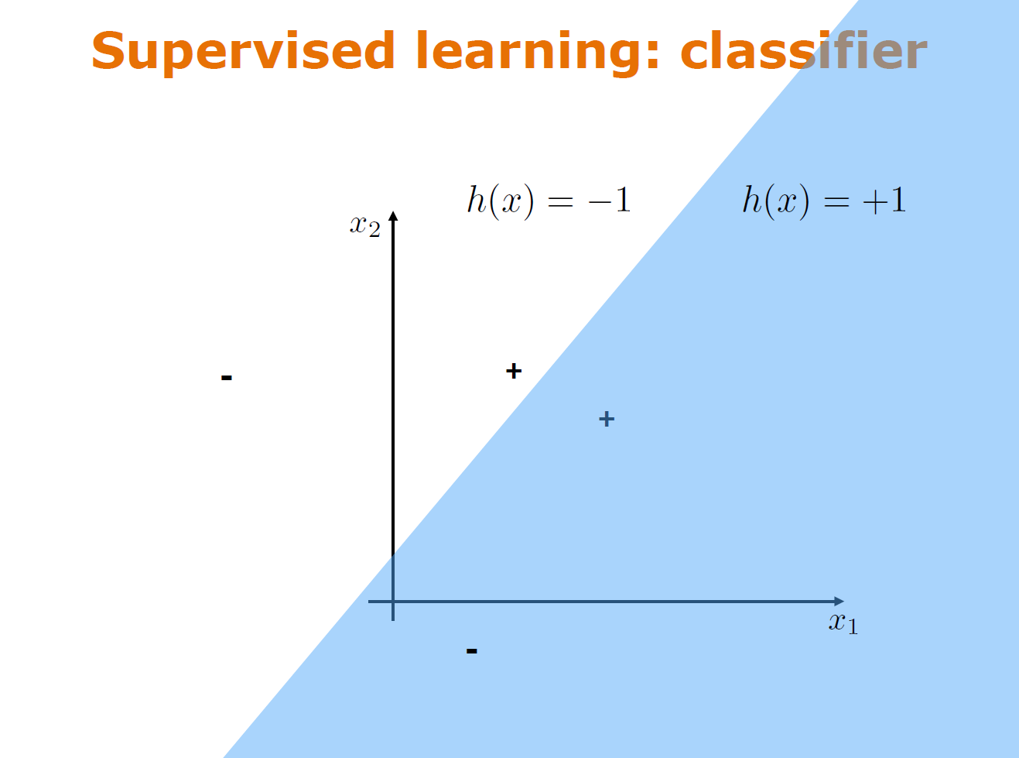

Slide 33
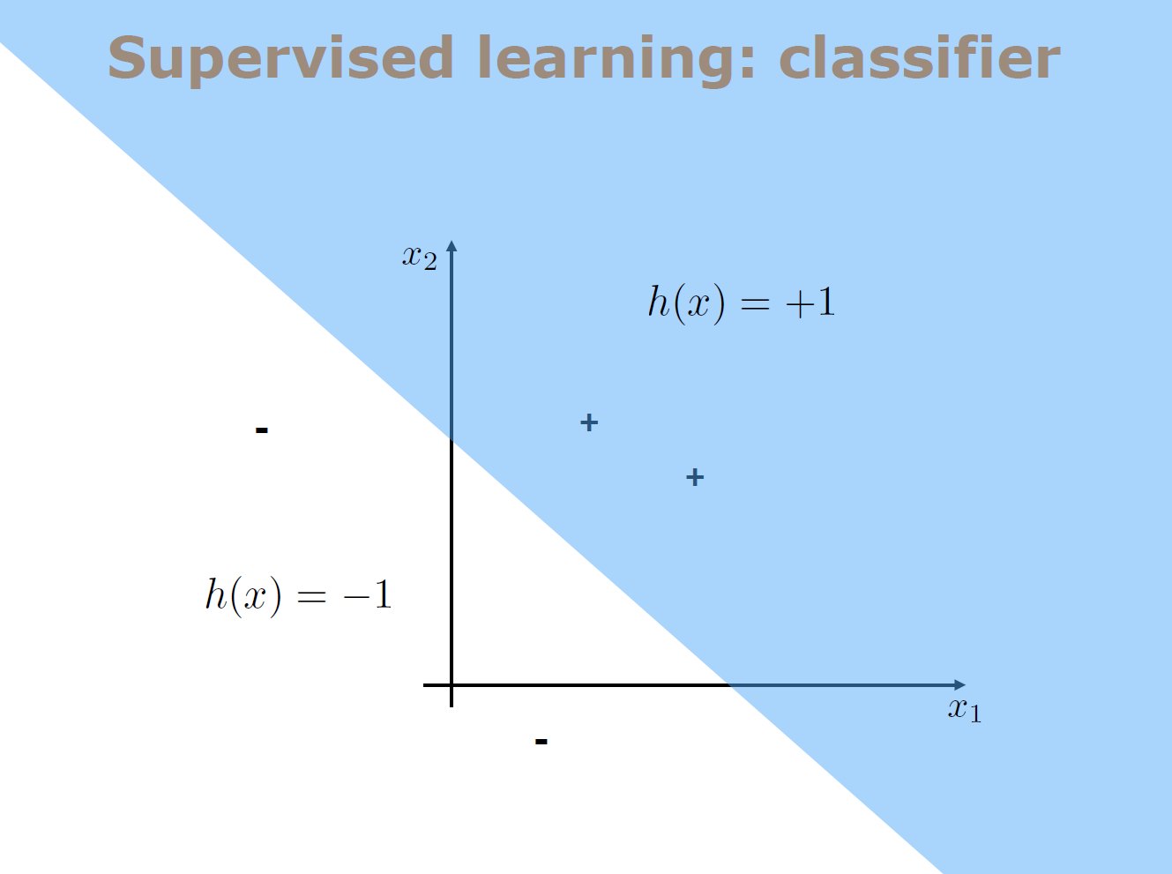

Slide 34
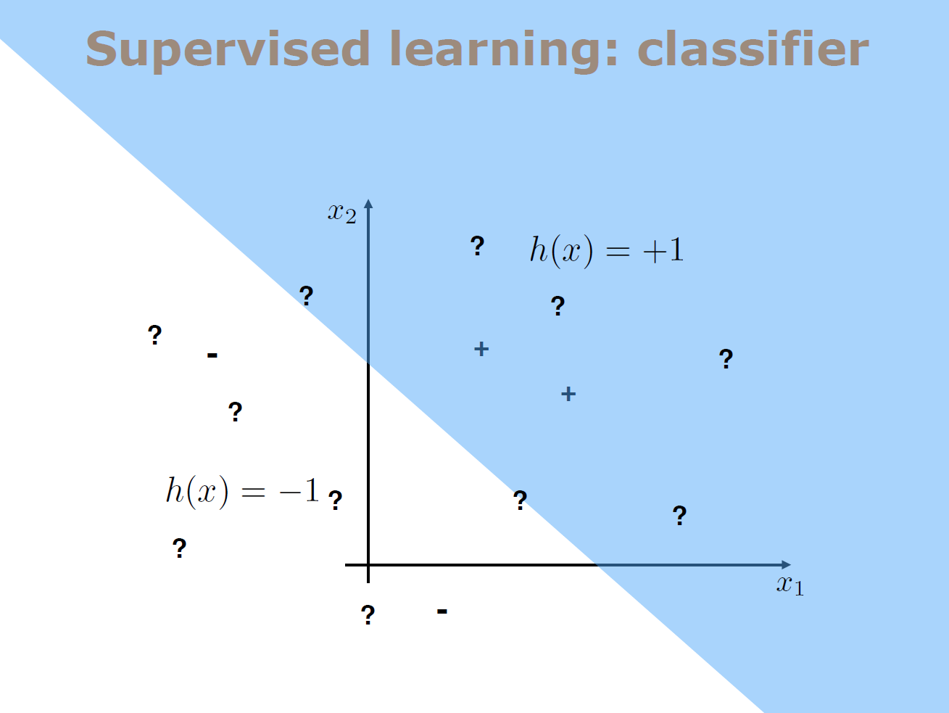

Slide 35
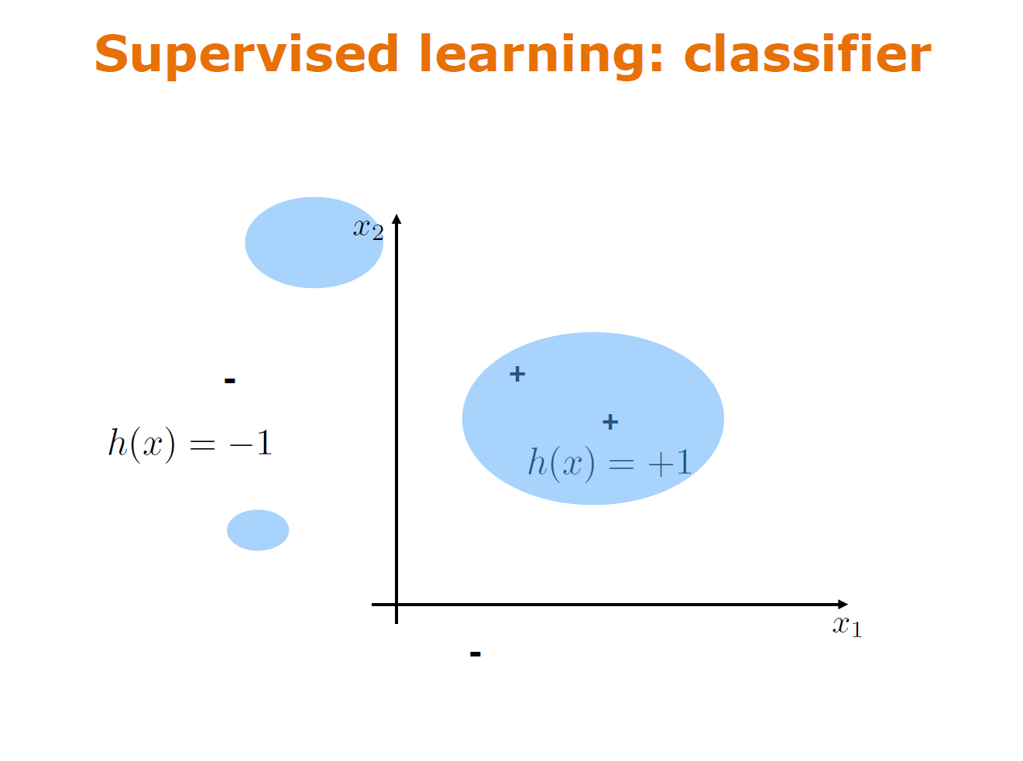

Slide 36
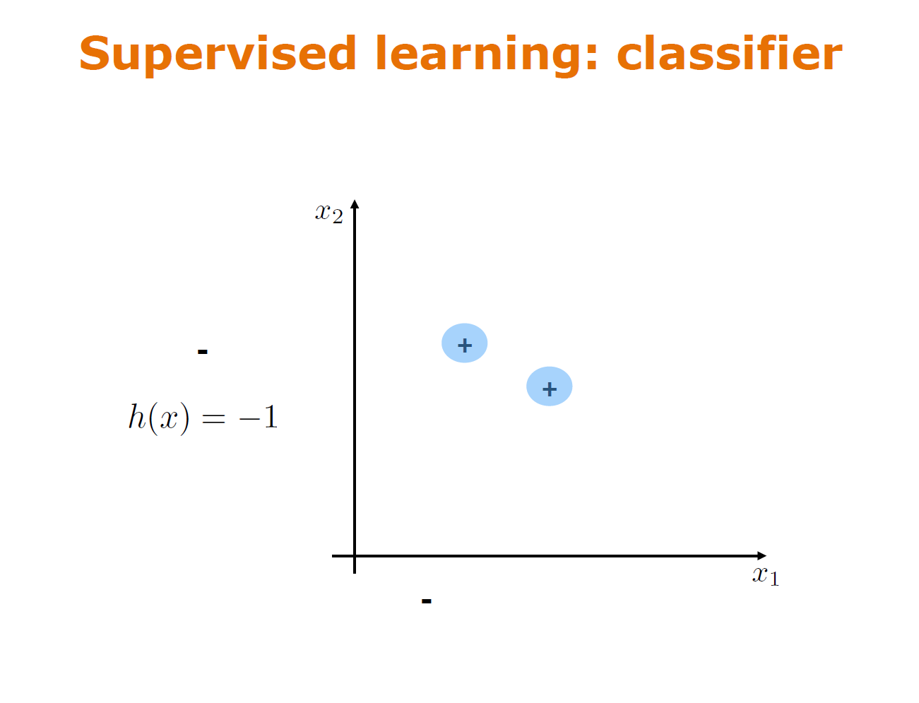

Slide 37
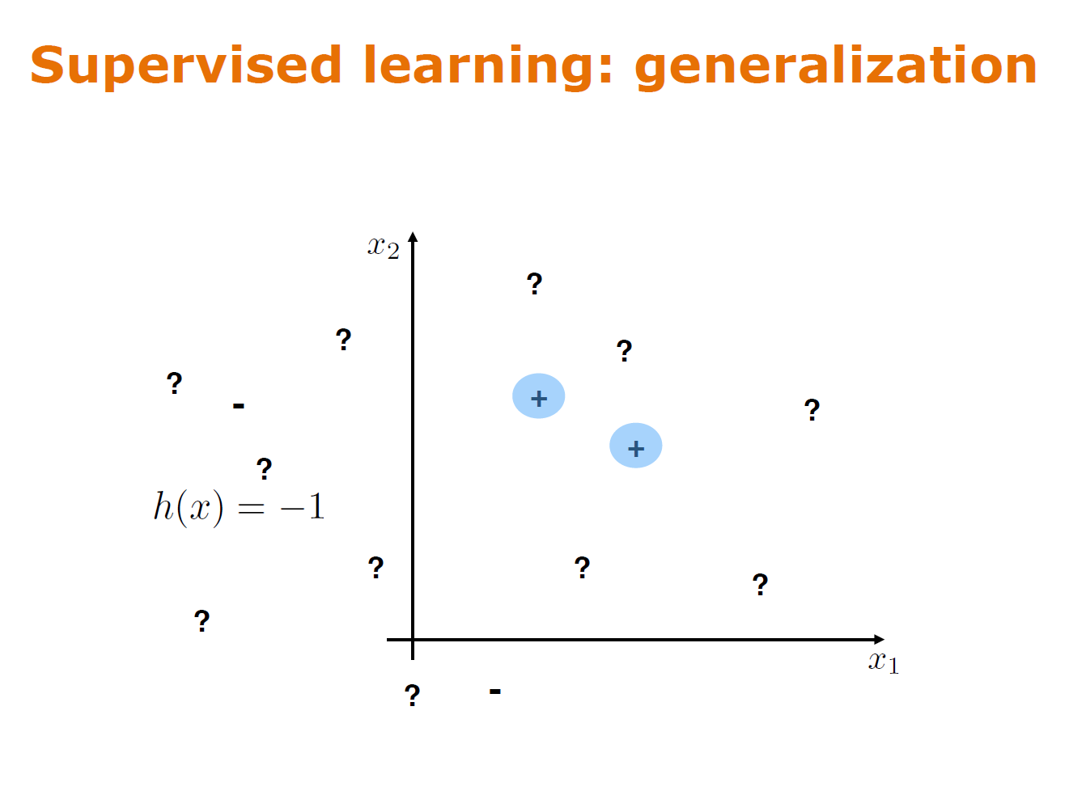

Slide 38
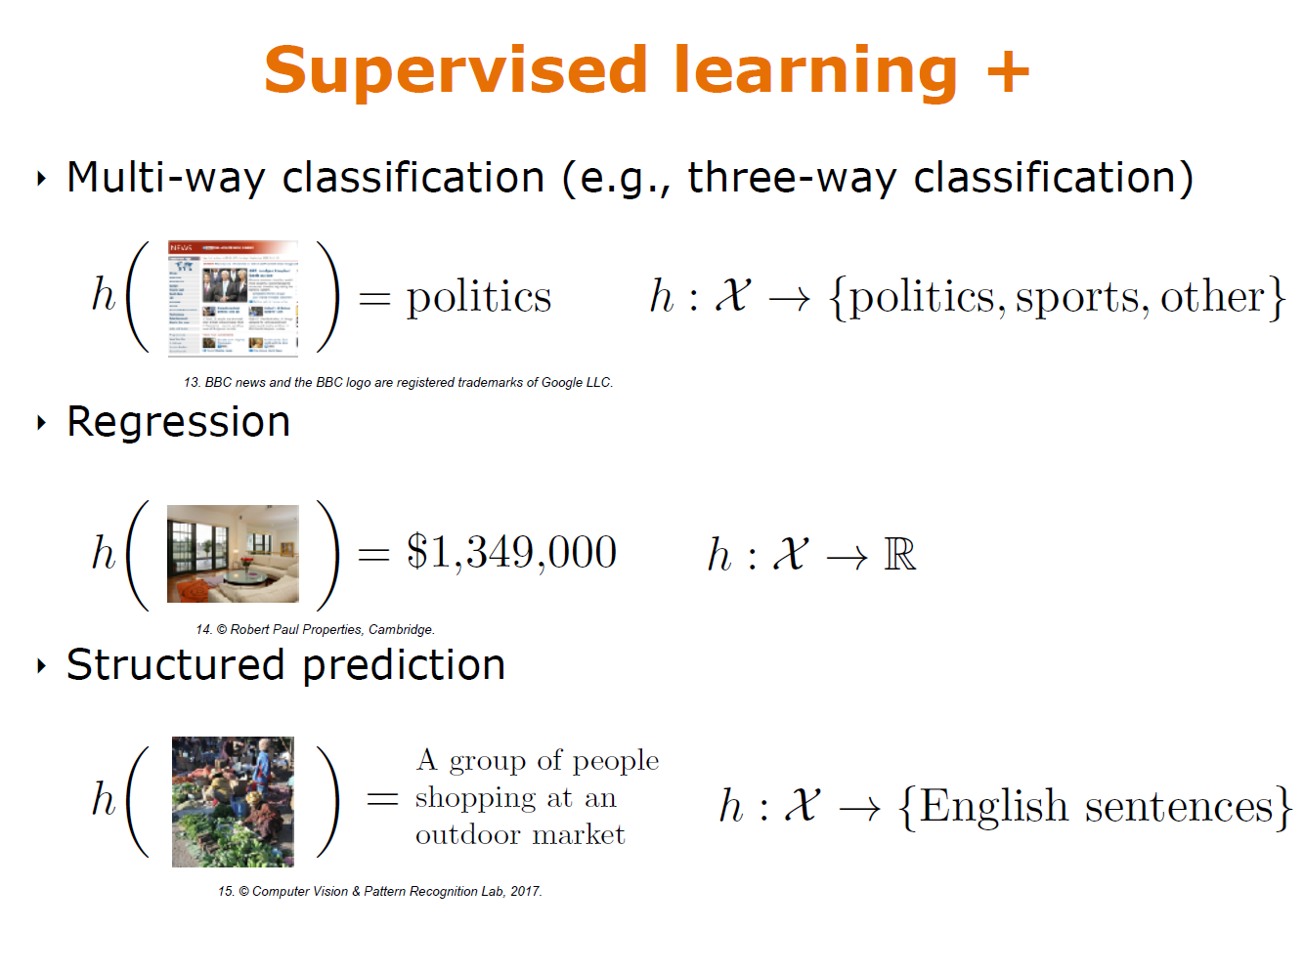

Slide 39
Machine learning setup
Binary classification, i.e., C = {0, 1} or C = {−1, +1}.
Multi-class classification, i.e., C = {1, 2, ⋯, K} (K ≥ 2).
Regression, i.e., C = ℝ (Regression can be used for prediction and both use continuous real numbers instead of discrete classes. )

Slide 40
Machine learning setup
There are multiple scenarios for the label space C:
Example-1: (Two-class (binary) classification) - Spam filtering.
An email is either a spam (+1), or not (−1).
Example-2: (Multi-class classification) - Face classification.
A person can be exactly one of K identities (e.g., 1=“Michelle", 2=“Thomas", …, K=”Mary”).
Example-3: (Prediction (for continuous variables)
Predict future temperature or the height of a person.
The goal of supervised learning is to find a function h: R^{d} → C, such that
h(x_{i}) ≈ y_{i} for all (x_{i} , y_{i} ) ∈ D (training); h(x_{i}) ≈ y_{i} for all (x_{i} , y_{i} ) ∉ D (testing).

Slide 41
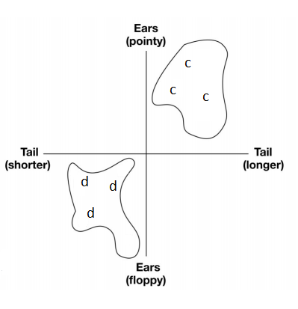
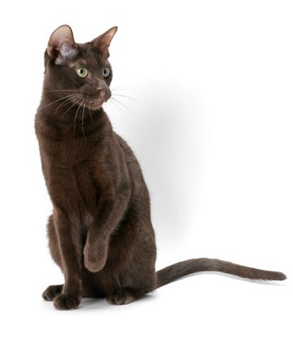
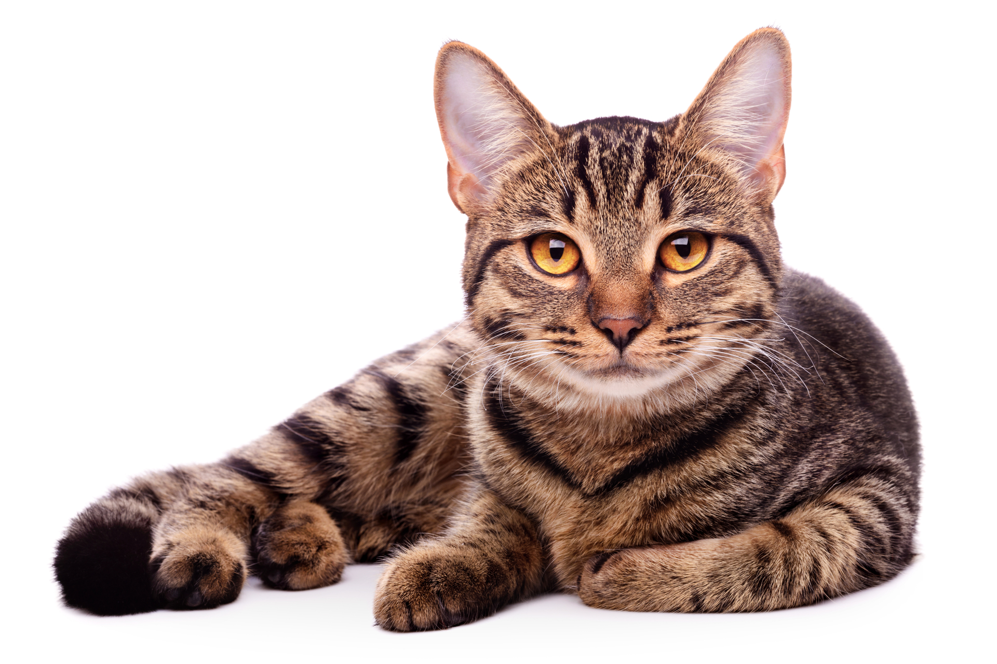
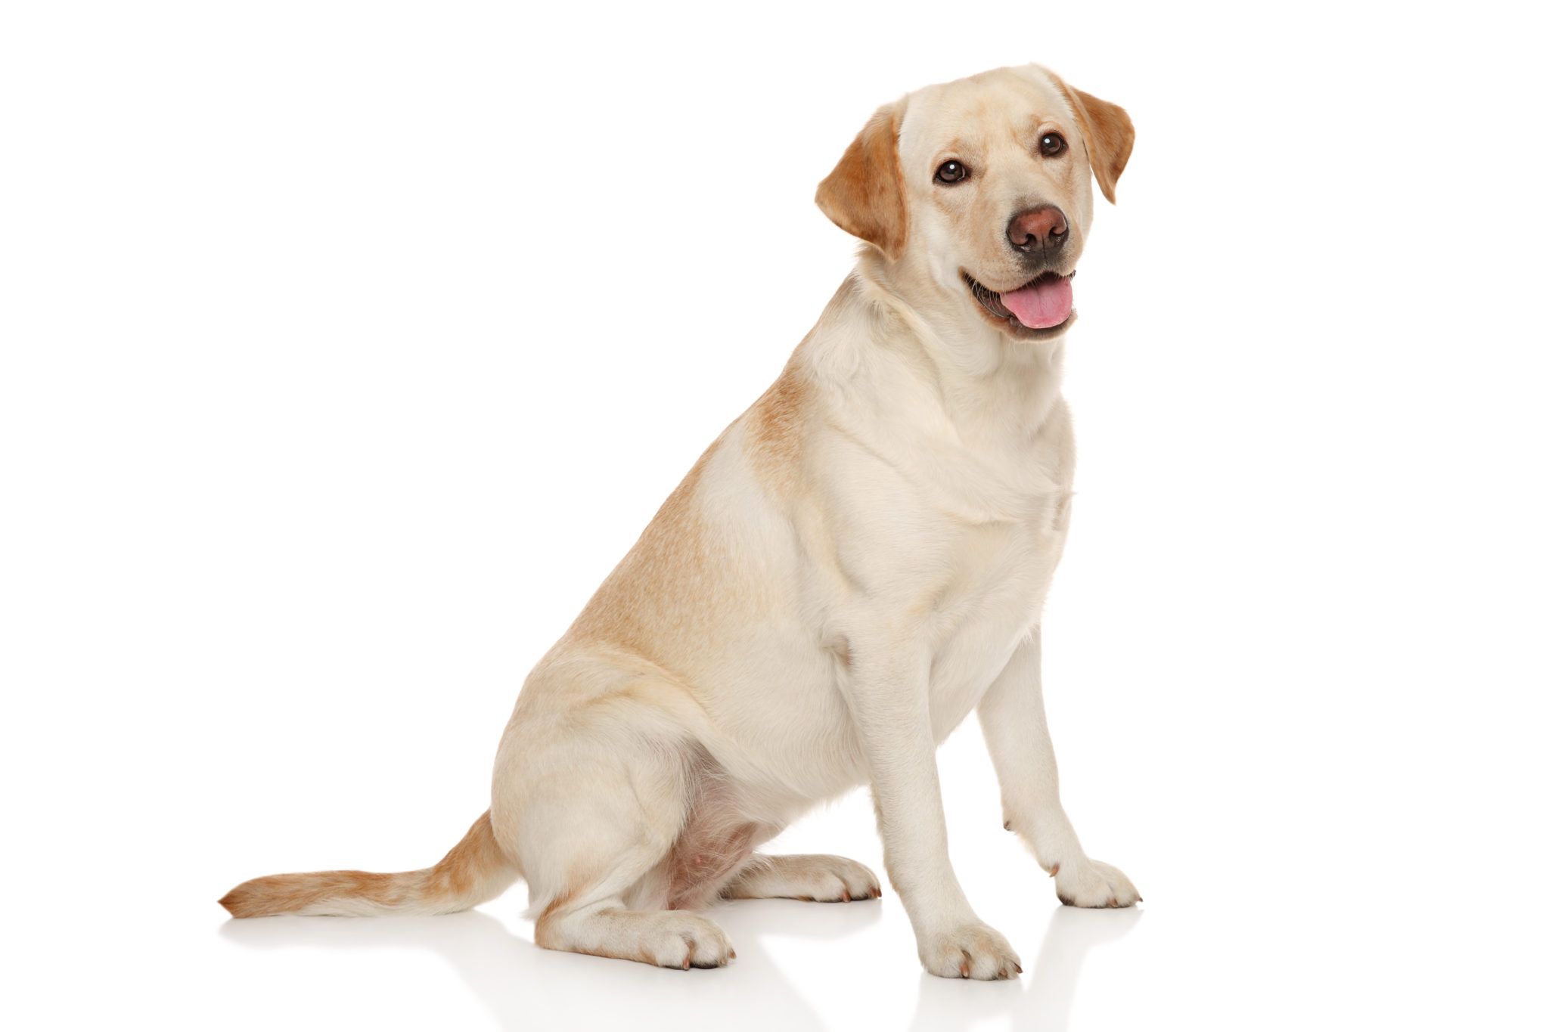
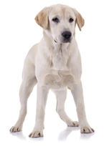
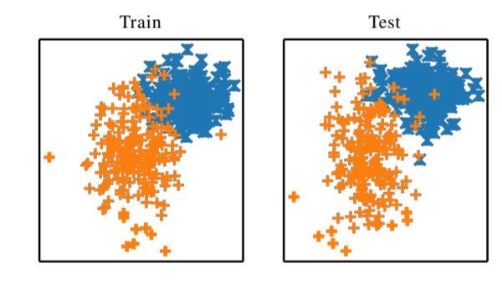
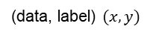
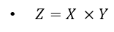
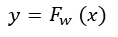
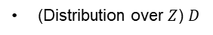
Fundamentals of Machine Learning
……..
Training
……..
Training Data
Model
$Z=X ×Y$
(data, label) $(x,y)$
$$y=F_{w} (x)$$
(Distribution over $Z$) $D$
Assumption: All training and test samples are drawn independently from the same distribution!
Notes:
So, the question becomes why is machine learning so brittle? If you think about the fundamentals of machine learning, one answer presents itself in an underlying assumption that the training and test samples are drawn from the same distribution. In the case of supervised ml, we usually gather a large amount of labeled training data. This is of course some sample of the overall possible data. The data contains features. Through optimization over the loss function, the relevant features shape the decision boundary for the resulting model. In this case, suppose the training has honed in on the type of ears and tail length of the animal. But again, the assumption is that the test data will have similar distribution to the training.

Slide 42
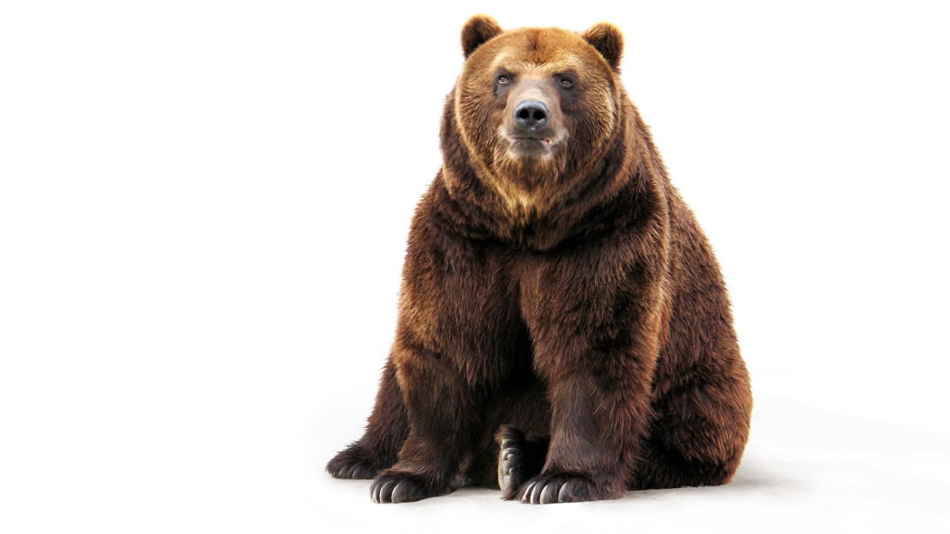
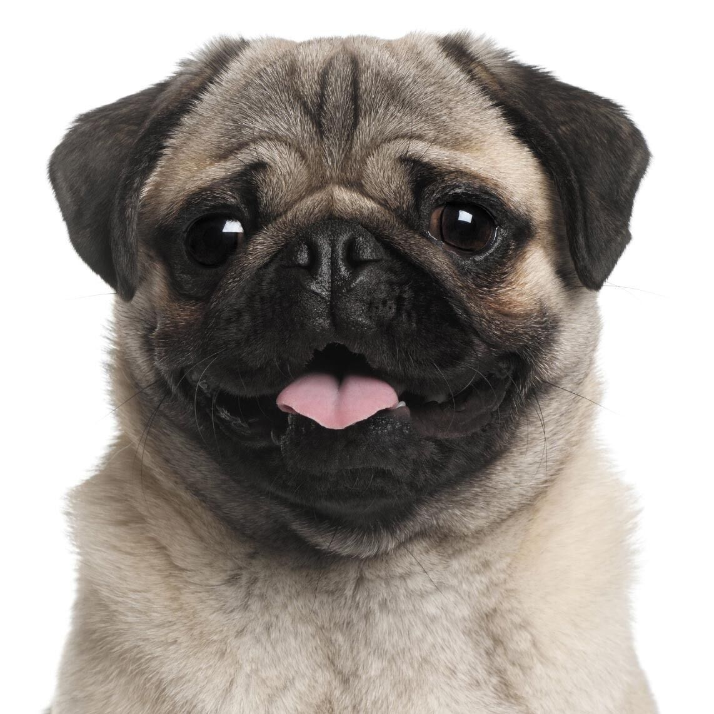
Machine Learning: Inference Time
c?
$$y=F_{w} (x)$$
d?
Model
Fundamental problem with closed set models; it will always have an answer when it should maybe say, “I don’t know!”
Notes:
At inference time, we supply a test sample and based on those features the model hopefully correctly predicts its class. Of course as a user of ML model, we are free to throw things up against the model that could be very outside of the training data distribution. Really, this is a fundamental problem with closed set models, they will always have an answer when maybe they should say I don’t know.

Slide 43




……..
……..
Training Data
Test Data
ML does not always generalize well!
Notes:
In the previous example, we supposed that the features of ears and tails were what the model was picking up on. But again, we might find that perhaps it really was fur color. And of course, there are dogs with pointy ears and cats with floppy ones so the model will not generalize well to types of animals outside the training set. Often models are repeatedly tested and one it hits a certain threshold for performance it is released. In other words, the metrics of success is how well it performs in these ideal settings.

Slide 44


Slide 45


Slide 46
Basic paradigm
Training data: Observe set of examples
Train a model: Infer something about process that generated that training data
Test data: Use inference to make predictions about previously unseen data
Supervised learning: given a set of feature/label pairs, find a rule that predicts the label associated with a previously unseen input
Unsupervised learning: given a set of feature vectors (without labels) group them into “natural clusters” (or create labels for groups)

Slide 47

Classification example: object recognition

Slide 48

Clustering example: semantic space

Slide 49

Unlabeled data

Slide 50
Clustering examples into groups
Want to decide on “similarity” of examples, with goal of separating into distinct, “natural”, groups
Similarity is a distance measure

Slide 51
Clustering examples into groups
Suppose we know that there are k different groups in our training data, but don't know labels (here k = 2)
Pick k samples (at random?) as exemplars
Cluster remaining samples by minimizing distance between samples in same cluster (objective function) − put sample in group with closest exemplar
Find median example in each cluster as new exemplar
Repeat until no change

Slide 52

Similarity based on weight

Slide 53
Similarity based on height

Slide 54

Cluster into Two Groups Using Both Attributes

Slide 55

Suppose Data Was Labeled

Slide 56
Finding Classifier Surfaces
Given labeled groups in feature space, want to find subsurface in that space that separates the groups
Subject to constraints on complexity of subsurface
In this example, have 2D space, so find line (or connected set of line segments) that best separates the two groups
When examples well separated, this is straightforward
When examples in labeled groups overlap, may have to trade off false positives and false negatives

Slide 57
Suppose Data Was Labeled
Given we have labeled data, then an obvious separator of two groups is shown

Slide 58

Adding Some New Data

Slide 59

Clustering using Unlabeled Data

Slide 60

Classified using Labeled Data

Slide 61
Machine Learning Methods
We will see some examples of machine learning methods:
Learn models based on unlabeled data, by clustering training data into groups of nearby points
Resulting clusters can assign labels to new data
Learn models that separate labeled groups of similar data from other groups
May not be possible to perfectly separate groups, without “overfitting”
But can make decisions with respect to trading off “false positives” versus “false negatives”
Resulting classifiers can assign labels to new data

Slide 62
All ML Methods Require:
Choosing training data and evaluation method
Representation of the features
Distance metric for feature vectors
Objective function and constraints
Optimization method for learning the model

Slide 63
Feature Representation
Features never fully describe the situation
”All models are wrong, but some are useful.” − George Box
Feature engineering
Represent examples by feature vectors that will facilitate generalization
Suppose l want to use 100 examples from past to predict, at the start of the subject, which students will get an A
Some features surely helpful, e.g., GPA, prior programming experience (not a perfect predictor)
Others might cause me to overfit, e.g., birth month, eye color
Want to maximize ratio of useful input to irrelevant input
Signal−to−Noise Ratio (SNR)

Slide 64

An Example
Features
Label
Initial model:
Not enough information to generalize

Slide 65
An Example
Features
Label
Name | Egg-laying | Scales | Poisonous | Cold- blooded | # legs |  | Reptile
Cobra | True | True | True | True | 0 |  | Yes
Rattlesnake | True | True | True | True | 0 |  | Yes
Initial model:
Egg laying
Has scales
ls poisonous
Cold blooded
No legs

Slide 66
An Example
Features
Label
Name | Egg-laying | Scales | Poisonous | Cold- blooded | # legs |  | Reptile
Cobra | True | True | True | True | 0 |  | Yes
Rattlesnake | True | True | True | True | 0 |  | Yes
Boa constrictor | False | True | False | True | 0 |  | Yes
Chicken True True False False 2 No
Alligator True True False True 4 Yes Dart frog True False True False 4 No Salmon True True False True 0 No Python True True False True 0 Yes
Initial model:
• Egg laying
• Has scales
• ls poisonous
• Cold blooded
• No legs
Current model:
Has scales
Cold blooded
No legs
Boa doesn't fit model, but is labeled as reptile.
Need to refine model

Slide 67
An Example
Features
Label
Name | Egg-laying | Scales | Poisonous | Cold- blooded | # legs |  | Reptile
Cobra | True | True | True | True | 0 |  | Yes
Rattlesnake | True | True | True | True | 0 |  | Yes
Boa constrictor | False | True | False | True | 0 |  | Yes
Chicken | True | True | False | False | 2 |  | No
Alligator True True False True 4 Yes
Dart frog True False True False 4 No Salmon True True False True 0 No Python True True False True 0 Yes
Current model:
Has scales
Cold blooded
No legs

Slide 68
An Example
Features
Label
Name | Egg-laying | Scales | Poisonous | Cold- blooded | # legs |  | Reptile
Cobra | True | True | True | True | 0 |  | Yes
Rattlesnake | True | True | True | True | 0 |  | Yes
Boa constrictor | False | True | False | True | 0 |  | Yes
Chicken | True | True | False | False | 2 |  | No
Alligator | True | True | False | True | 4 |  | Yes
Dart frog True False True False 4 No
Salmon True True False True 0 No Python True True False True 0 Yes
Current model:
Has scales
Cold blooded
Has 0 or 4 legs
Past model:
• Has scales
• Cold blooded
• No legs
Alligator doesn't fit model, but is labeled as reptile.
Need to refine model

Slide 69
An Example
Features
Label
Name | Egg-laying | Scales | Poisonous | Cold- blooded | # legs |  | Reptile
Cobra | True | True | True | True | 0 |  | Yes
Rattlesnake | True | True | True | True | 0 |  | Yes
Boa constrictor | False | True | False | True | 0 |  | Yes
Chicken | True | True | False | False | 2 |  | No
Alligator | True | True | False | True | 4 |  | Yes
Dart frog | True | False | True | False | 4 |  | No
Salmon True True False True 0 No
Python True True False True 0 Yes
Current model:
Has scales
Cold blooded
Has 0 or 4 legs

Slide 70
An Example
Features
Label
Name | Egg-laying | Scales | Poisonous | Cold- blooded | # legs |  | Reptile
Cobra | True | True | True | True | 0 |  | Yes
Rattlesnake | True | True | True | True | 0 |  | Yes
Boa constrictor | False | True | False | True | 0 |  | Yes
Chicken | True | True | False | False | 2 |  | No
Alligator | True | True | False | True | 4 |  | Yes
Dart frog | True | False | True | False | 4 |  | No
Salmon | True | True | False | True | 0 |  | No
Python | True | True | False | True | 0 |  | Yes
Current model:
Has scales
Cold blooded
Has 0 or 4 legs
No (easy) way to add to rule that will correctly classify salmon and python (since identical feature values)
3f

Slide 71
An Example
Features
Label
Name | Egg-laying | Scales | Poisonous | Cold- blooded | # legs |  | Reptile
Cobra | True | True | True | True | 0 |  | Yes
Rattlesnake | True | True | True | True | 0 |  | Yes
Boa constrictor | False | True | False | True | 0 |  | Yes
Chicken | True | True | False | False | 2 |  | No
Alligator | True | True | False | True | 4 |  | Yes
Dart frog | True | False | True | False | 4 |  | No
Salmon | True | True | False | True | 0 |  | No
Python | True | True | False | True | 0 |  | Yes
Good model: Has scales Cold blooded | Not perfect, but no false negatives (anything classified as not reptile is correctly labeled); some false positives (may incorrectly label some animals as reptile)
6.0002 LECTURE ff
71

Slide 72
Need to Measure Distances between Features
Feature engineering:
Deciding which features to include and which are merely adding noise to classifier
Defining how to measure distances between training examples (and ultimately between classifiers and new instances)
Deciding how to weight relative importance of different dimensions of feature vector, which impacts definition of distance
6.0002 LECTURE ff
72

Slide 73
Measuring Distance Between Animals
We can think of our animal examples as consisting of four binary features and one integer feature
One way to learn to separate reptiles from non− reptiles is to measure the distance between pairs of examples, and use that:
To cluster nearby examples into a common class (unlabeled data), or
To find a classifier surface in space of examples that optimally separates different (labeled) collections of examples from other collections
rattLesnake = [1,1,1,1,0]
Boa constrictor = [0,1,0,1,0]
Dart Frog = [1,0,1,0,4]
Can convert examples into feature vectors

Slide 74

Minkowski Metric

Slide 75



Euclidean Distance Between Animals
rattLesnake = [1,1,1,1,0]
Boa constrictor = [0,1,0,1,0] dartFrog = [1,0,1,0,4]
Images of rattlesnake, dart frog, boa constrictor © sources unknown. All rights reserved. This content is excluded from our Creative Commons license. For more information, see https://ocw.mit.edu/help/faq-fair-use/.

Slide 76

Euclidean Distance Between Animals
rattLesnake = [1,1,1,1,0]
Boa constrictor = [0,1,0,1,0] dartFrog = [1,0,1,0,4]
Using Euclidean distance, rattlesnake and boa constrictor are much closer to each other, than they are to the dart frog

Slide 77


Add an Alligator
alligator =Animal('alligator',[1,1,0,1,4])
animals.append(alligator)
compareAnimals(animals, 3)
Image of alligator © source unknown. All rights reserved. This content is excluded from the Creative Commons license. For more information, see https://ocw.mit.edu/help/faq-fair-use/.

Slide 78





Add an Alligator
alligator = Animal('alligator', [1,1,0,1,4])
animals.append(alligator)
compareAnimals(animals, 3)
Alligator is closer to dart frog than to snakes − why?
Alligator differs from frog in 3 features, from boa in only 2 features
But scale on “legs” is from 0 to 4, on other features is 0 to 1
“legs” dimension is disproportionately large

Slide 79





Using Binary Features
rattLesnake = [1,1,1,1,0]
Boa constrictor = [0,1,0,1,0] dartFrog = [1,0,1,0,4]
Alligator = [1,1,0,1,1]
Now alligator is closer to snakes than it is to dart frog
− makes more sense
Feature Engineering Matters

Slide 80
Issues of Concern When Learning Models
Learned models will depend on:
Distance metric between examples
Choice of feature vectors
Constraints on complexity of model
Specified number of clusters
Complexity of separating surface
Want to avoid overfitting problem (each example is its own cluster, or a complex separating surface)
80

Slide 81
Clustering approaches
Suppose we know that there are k different groups in our training data, but don't know labels
Pick k samples (at random?) as exemplars
Cluster remaining samples by minimizing distance between samples in same cluster (objective function) − put sample in group with closest exemplar
Find median example in each cluster as new exemplar
Repeat until no change
lssues:
How do we decide on the best number of clusters?
How do we select the best features, the best distance metric?
81

Slide 82


Clustering using Unlabeled Data

Slide 83

Fitting Three Clusters Unsupervised

Slide 84
Classification approaches
Want to find boundaries in feature space that separate different classes of labeled examples
Look for simple surface (e.g. best line or plane) that separates classes
Look for more complex surfaces (subject to constraints) that separate classes
Use voting schemes
Find k-nearest training examples, use majority vote to select label
lssues:
How do we avoid over−fitting to data?
How do we measure performance?
How do we select best features?
6.0002 LECTURE ff
46

Slide 85

Classification
Attempt to minimize error on training data
Similar to fitting a curve to data
Evaluate on training data
Voter preference, by age and distance from Boston

Slide 86

Randomly Divide Data into Training and Test Set

Slide 87

Two Possible Models for a Training Set

Slide 88



Confusion Matrices (Training Error)

Slide 89
Training Accuracy of Models
0.7 for both models
Which is better?
Can we find a model with less training error?

Slide 90

A More Complex Model
TP = 12, FP = 5, TN = 13, FN = 0
Accuracy = 25/30 = 0.833

Slide 91

Applying Model to Test Data
TP = 14, FP = 4, TN = 4, FN = 8
Accuracy = 18/30 = 0.6

Slide 92

Other statistical measures:
precision =

Slide 93
Summary
Machine learning methods provide a way of building models of processes from data sets
Choice of features influences results
Choice of distance measurement between examples influences results
We will see some examples of clustering methods, such as k−means
We will see some examples of classifiers, such as k-nearest neighbor methods
93

Slide 94
Summary
Supervised learning uses labeled data, and creates classifiers that optimally separate data into known classes
Unsupervised learning tries to infer latent variables by clustering training examples into nearby groups
94

Slide 95
Machine learning setup
Let us formalize the supervised machine learning setup. Our training data comes in pairs of inputs (x, y), where x ∈ R ^{d} is the input instance and y its label. The entire training data is denoted as:
D = {(x₁,y₁), …, (x_{n},y_{n})} ⊆ R ^{d} × C
where:
R ^{d}: d-dimensional feature space
x_{i}: input vector of the i^{th} sample
y_{i}: label of the i^{th} sample
C: label space

Slide 96
Machine learning setup
Binary classification, C = {0, 1} or C = {−1, +1}
Multi-class classification, C = {1, 2, ⋯, K} (K ≥ 2)

Slide 97
Machine learning setup
}Categorical
Binary classification, C = {0, 1} or C = {−1, +1}
Multi-class classification, C = {1, 2, ⋯, K} (K ≥ 2)

Slide 98
Machine learning setup
}Categorical
Binary classification, C = {0, 1} or C = {−1, +1}
Multi-class classification, C = {1, 2, ⋯, K} (K ≥ 2)
Regression, C = ℝ (Regression for predicting real numbers instead of distinct classes.)

Slide 99
Feature vectors
x_{i}^{d} : d dimensional feature vector of the i^{th} sample
x_{i} = { x¹_{i} , x²_{i} , x³_{i} , x⁴_{i} , … , x³⁰⁰_{i} } 300 dimensions of the i^{th} sample.
Dense feature vectors:
A large number of the 300 features of the i^{th} sample are nonzero.
Sparse feature vectors:
A large number of the 300 features of the i^{th} sample are zero.
High dimensional feature vectors:
d = 10,000
Notes:
Health information data, ith word in a dictionary presence or tf in a document, 7Mp camera with rgb 7x3M=21M features
Sparse vector is the movies you have seen on netflix or amazon prime and then use that for collaborative filtering to find the instances that are most similar to you and what other movies they watched.

Slide 100

Curse-of-Dimensionality
Prediction accuracy can quickly degrade when number of attributes grows.
Irrelevant attributes easily “swamp” information from relevant attributes
When many irrelevant attributes, similarity/distance measure becomes less reliable
Remedy
Try to remove irrelevant attributes in pre-processing step
Weight attributes differently
Increase k (but not too much)
Notes:
Prediction accuracy can quickly degrade when number of attributes grows.
Imagine attribute vector (y,r1,r2,r3,…,rN),
first feature always tells the label
r1,..rn take random binary values.
What is the probability that nearest neighbor has same label? P(y=yNN)
Similarity measure is number of mismatches.
Assume we have only two training examples, one for each label. Both training examples have distance N+1 (all bits different) (-1,+1,-1,+1,-1,+1,…,-1) (+1,-1,+1,-1,+1,-1,…,+1)
If N=0, then P(y=yNN)=1
If N=2, then P(y=yNN)=3/4 → need both random attributes to match the wrong examples (4 outcomes on random attributes, and only one leads to a mistake)
If N=4, then P(y=yNN)=11/16 → need three random attributes to match the wrong examples (16 outcomes on random attributes, and 5 lead to a mistake)
If N=100, then P(y=yNN) almost 1/2 → need N/2+1 random attributes to match the wrong examples
For every random attribute, we need exponentially more training examples.

Slide 101
Hypothesis classes
Hypothesis class: What function represents the relationship between the input vector and labels?
Hypothesis: Guess and make assumptions to come up with a hypothesis
No free lunch theorem: Accordingly no one ml method can be a good fit for all problems because each time there have to be assumptions.

Slide 102

Loss functions aka risk functions
Zero / one loss = error rate on this dataset D.

Slide 103

Loss functions aka risk functions
Squared loss
If is a large difference, penalty gets magnified.

Slide 104

Loss functions aka risk functions
Absolute loss
Penalties don’t get magnified when is large .

Slide 105

Generalization
Find function h that minimizes the loss

Slide 106

Minimum loss
Loss would be zero
Overfitting ≈ no generalization

Slide 107
Train / Test splits
Training data: learn from this (%80 of data)
Validation data check if you learned the patterns accurately (%10 of data)
Test data Evaluate the hypothesis (%10 of data)

Slide 108

Train / Test splits
Training data: learn from this (%80 of data)
Validation data check if you learned the patterns accurately (%10 of data)
Test data Evaluate the hypothesis (%10 of data)
Notes:
Find a min loss hypothesis

Slide 109

Train / Test splits
Training data: learn from this (%80 of data)
Validation data check if you learned the patterns accurately (%10 of data)
Test data Evaluate the hypothesis (%10 of data)
Often used for parameter tuning of the model.
Notes:
Keep validating and tweaking the hypothesis until the validation loss is small

Slide 110

Train / Test splits
Training data: learn from this (%80 of data)
Validation data check if you learned the patterns accurately (%10 of data)
Test data Evaluate the hypothesis (%10 of data)

Slide 111
Different Learning Methods
Eager Learning
Explicit description of target function on the whole training set
Instance-based Learning
Learning=storing all training instances
Classification=assigning target function to a new instance
Referred to as “Lazy” learning

Slide 112

k-nearest neighbors aka kNN

Slide 113
k-nearest neighbors aka KNN
Non-parametric (no assumptions about underlying distribution)
Try knn when there is no prior information on data’s distribution
Lazy
Not eager
No generalization (no real training phase instead instance based)
Simple
Can be used for classification or regression
K closest neighbors
Majority vote for classification
Mean or median for regression

Slide 114
k-nearest neighbors application areas
Credit rating
Loan decisions
Binary vote classification
Advanced
OCR (optical character recognition)
Handwriting recognition
Object recognition
Video recognition

Slide 115

k-nearest neighbors
Notes:
(Hint: In case of a draw, a good solution is to return the result of k-NN with smaller k)
Knn better at lower dimensions - curse of dimensionality

Slide 116


k-nearest neighbors
and
Notes:
(Hint: In case of a draw, a good solution is to return the result of k-NN with smaller k)
For all instances that are in the dataset but not one of the k neighbors.

Slide 117

k-nearest neighbors
If k = 3, then x = ⊕
since there are (2 x ⊕) and only one ⊖
and
Notes:
(Hint: In case of a draw, a good solution is to return the result of k-NN with smaller k)
For all instances that are in the dataset but not one of the k neighbors.
l and not useful if k=1 then it overfits. If n goes to infinity k=1 is a factor of two worse than the optimal classifier

Slide 118


Minkowski distance
Notes:
P = infinity then the distance is the maximum difference at a certain d
What happens in edge cases? When something goes to 0 or infinity.
Max norm basically ends up giving the maximum distance at one dimension

Slide 119
Voronoi Diagram
Decision surface formed by the training examples

Slide 120
Distance Metrics
Different metrics can change the decision surface
Standard Euclidean distance metric:
Two-dimensional: Dist(a,b) = sqrt((a₁ – b₁)² + (a₂ – b₂)²)
Multivariate: Dist(a,b) = sqrt(∑ (a_{i} – b_{i})²)
Dist(a,b) =(a₁ – b₁)² + (3a₂ – 3b₂)²
Dist(a,b) =(a₁ – b₁)² + (a₂ – b₂)²

Slide 121
K Nearest Neighbor Algorithm

Slide 122
KNN pros and cons
Pros
Simple (easy to explain and interpret)
Versatile (both for classification and regression)
No assumption about data distributions
Relatively high accuracy (for such a simple method)
Cons
Computationally expensive
Stores all training data - high memory requirement
Can be slow especially when n is large
Sensitive to irrelevant features and scale

Slide 123

Homework 1 Overview
Final Project Discussion

Slide 124


